Slide 1
DAVI CA2 Plotly Objective: To understand the student population well and gain a deeper understanding of the demographics Name: Isaac Low ID: p2342348

Slide 2
agenda
Nature of the dataset
Data cleansing and wrangling
Charts
Insights
Conclusion and recommendation

Slide 3
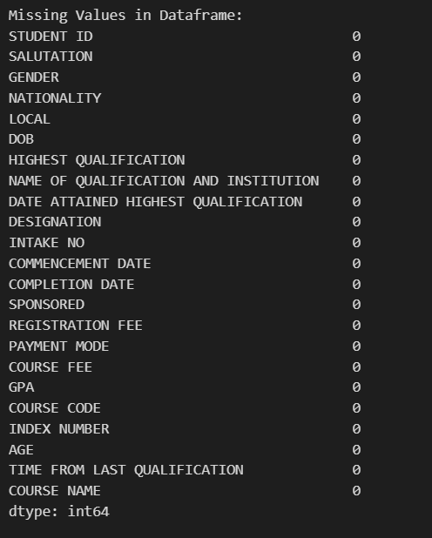

Nature of dataset
The data is generally the same as the seaborn assignment and is already cleaned with no missing values. However, as an effect of converting to csv and back, the datetime columns have been converted to object, lets fix that.

Slide 4

Data wrangling and cleansing
In the previous assignment, I encoded the local, gender and sponsored columns for a specific task, so I am going to unencode it. I am also going to turn the datetime columns back into datetime format, and also derive an age range column to use later. In the previous part I didn’t notice that some PRs were labelled as locals so I changed that here.

Slide 5
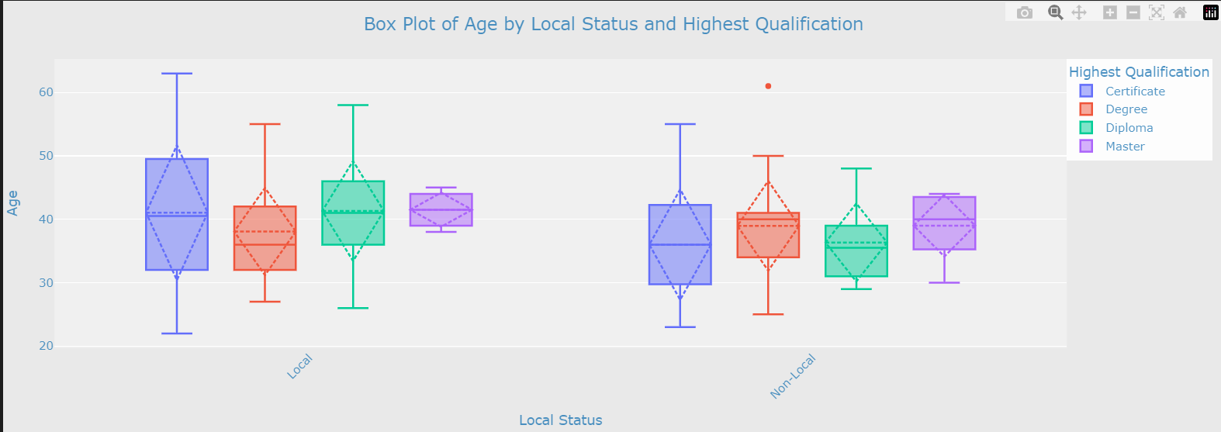
Chart 1: box plot
Insights:
We can see that for local students, the highest qualification with the lowest median age is degree and the course of study with the highest median age is diploma
For non-local students, the highest qualification with the lowest age is the certificate, and the highest qualification with the highest age is the masters.
For non locals, the distribution is pretty intuitive, with higher qualifications being higher in age while for local students not so much. This suggests that for foreign students, they may be required to get a local certificate to work in Singapore hence they enrol in this educational institute, while for local students, they just want to upskill themselves leading to such a distribution.

Slide 6
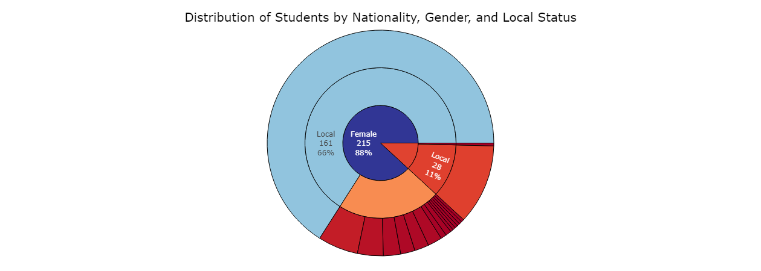
Chart 2: Sunburst Chart
Insights:
Through this sunburst chart we can see the proportion of local and overseas students, the proportion of overseas students from each country and the proportion of males to females.
We can see that the population is overwhelmingly female at 88%, and mostly comprised of local students.
We can also see that there are many nationalities for the different female students but for the males, only Singaporean and one Malaysian PR, suggesting an unbalanced demographic

Slide 7
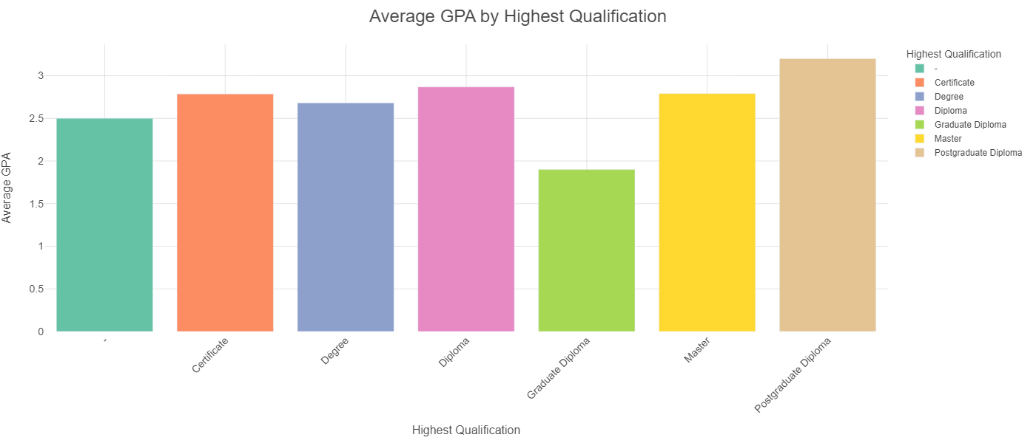
Chart 3: Plotly dash Bar chart
Shows Average GPA by Highest Qualification and Age Range
Insights: we can see that the highest qualification that produces the highest GPA is the post graduate degree is the postgraduate diploma, and the one that produces the lowest GPA is the Graduate diploma.
Through using the sliders and the checkboxes, we can isolate particular groups within the dataset and gain more insights through that.
Some highest qualifications do have low populations, causing the average to be skewed

Slide 8
Conclusion and Recommendation
The plots show a very diverse and varied pool of students, however the students are overwhelmingly female and local. This issue in demographics may lead to less diverse thoughts and ideals which may not be positive for the Singaporean workforce. The higher median ages across the board also suggests that this institute is attracting students who are trying to upskill or try a mid career switch which is a very positive thing for the economy. However, for the bar chart, the fact that people who took masters are having a lower average gpa than other lower qualifications may be an issue as it could point toward a syllabus that is not good, given that the supposedly higher educated population is suffering in terms of score.
A suggestion would be to increase the diversity of the student pool and even out the gender ratios as this over emphasis on female admissions may cause some inequality concerns. Another would be to look at the syllabus to ensure that the course work is consistent and up to date due to the issue that the higher qualified population is doing worse

Slide 9
Thank you

